Slide 1
Azure Compute
Global Azure Bootcamp
April 22, 2017
Jason Haley

Slide 2
Azure Services
Compute Services
Data Services
Application Services
Network Services
Notes:
Compute = VM’s, app service, cloud service, etc.
Data Services = Storage (table, queue, blobs, drives), SQL, DocumentDb, Redis, HDInsight, Search, etc.
Application Services = Notification hubs, service bus, media services, biztalk services, AAD, scheduler, CDN, MFA, Automation, etc.
Networking Services = Virtual network, traffic manager, vpn, express route, dns, application gateway, etc.

Slide 3
Compute – how to Run your code
IaaS |  | PaaS
Virtual Machines | Service Fabric | Cloud Services
Azure Container Service |  | App Service
 |  | Functions
CPU
Memory
Disk space
Configuration

Slide 4
Virtual Machines
IaaS
Quickest way to “Lift and Shift” your application to the cloud
Linux and Windows
Many prebuilt images, bring your own or build what you need
Various CPU, memory and disk sizes
Scale Sets (auto scale VMs for high availability)
Virtual Networking
Notes:
Virtual machine scale sets are an Azure Compute resource you can use to deploy and manage a set of identical VMs.
With all VMs configured the same, VM scale sets are designed to support true autoscale – no pre-provisioning of VMs is required – and as such makes it easier to build large-scale services targeting big compute, big data, and containerized workloads.

Slide 5
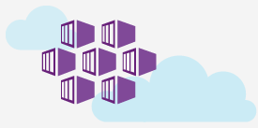
Azure Container Service
IaaS
Docker Container hosting
Can use orchestrators: DC/OS, Kubernetes or Docker Swarm
Linux and Windows
Various CPU, memory and disk sizes

Slide 6
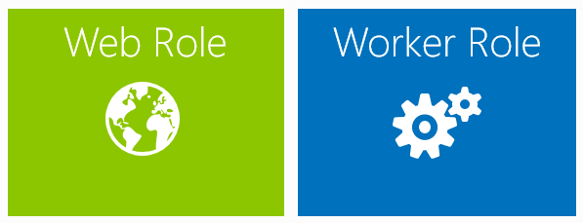
Cloud Services
PaaS
Worker or Web Role
Various sizes
Support for Java, nodejs, PHP, Python, .NET and Ruby
Auto Scale
Virtual Networking

Slide 7
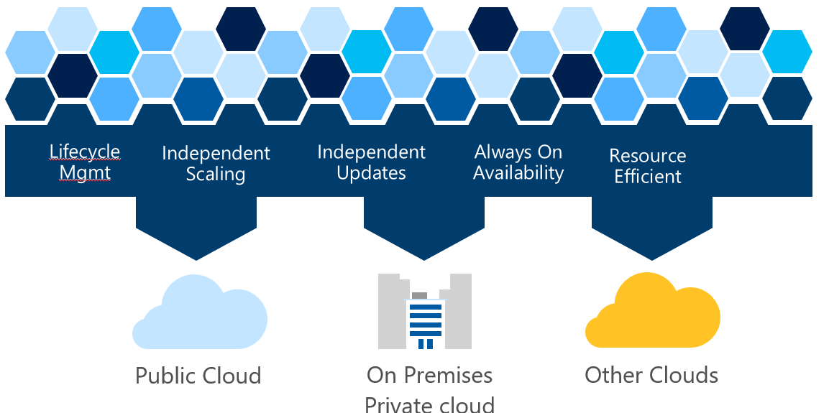
Service FAbric
Evolution of PaaS
Microservices Platform
Fast deployment
Placement and activation
Reliability
High density
Health reporting
Coordinated upgrades
Notes:
Internal Services built using
-Azure database
-DocumentDb
-Event Hub
-IoT Hub
-Intune
-Skype for business

Slide 8

App Service
PaaS
Web App
Scalable web apps
Mobile App
A mix of backend services for mobile apps
API App
Cloud APIs without a web app
Logic App
Workflow orchestration of APIs and data access
Function App
Event driven compute-on-demand
Notes:
https://azure.microsoft.com/en-us/services/app-service/mobile/
Build engaging iOS, Android, and Windows apps
Broadcast push with customer segmentation
Enterprise single sign-on with Active Directory
Autoscale to support millions of devices
Apps can work offline and sync
Social integration with Facebook, Twitter, Google
https://azure.microsoft.com/en-us/services/app-service/api/
Quickly build and consume APIs in the cloud using the language of your choice
Secure APIs with Active Directory, single sign-on, and OAuth
Generate client proxies or APIs in your language of choice
Mashup existing enterprise APIs
Integrate with API Management and Logic Apps
https://azure.microsoft.com/en-us/services/app-service/logic/
Develop and deliver powerful integration solutions with ease
Create business processes and workflows visually
Deliver integration capabilities in web, mobile, and API apps
Integrate with your SaaS and enterprise applications
Automate EAI, B2B, and business processes
Connect to on-premises data

Slide 9
Hands on Labs
Virtual Machine
Create a virtual machine
Add extension for IIS and WebDeploy
Connect using RDP
Configure network security group for HTTP and WebDeploy
Deploy sample web application to VM
App Service
Create web app
Deploy sample web application to web app

